Slide 1
Online Quiz System
MCQ-based quiz with scoring
Presented by
NAVYA SREE-24KB1A05FK
DEEKSHITHA-24KB1A05FP
SRUTHI-24KB1A05FX
NASREEN-24KD1A05JA

Slide 2
Introduction and program overview
A simple multiple-choice quiz program written in C.
Main Features:
  Three multiple-choice questions.
  Timer functionality (optional).
  Tracks and displays the user's score.
  Saves high scores to a file and displays them.

Slide 3
Program and MCQ Structure
Program Structure:
  MCQ Structure: Stores questions, options, and answers.
  Functions:
    loadSampleQuestions(): Loads predefined questions.
    saveHighScore(): Saves high scores to a file.
    showHighScores(): Displays high scores.
MCQ Structure:
  question: Stores the text of the question.
  options: Array holding options (A, B, C, D).
  answer: Stores the correct answer (e.g., 'A', 'B').

Slide 4
Quiz Logic and Timer
Quiz Logic:
  User answers questions (A, B, C, D).
  Program checks answers and updates the score.
  Displays score after the quiz.
Timer Functionality:
  Timer is optional based on user input.
  Ends quiz if 60 seconds pass.

Slide 5
High Scores and User Interaction
High Score System:
  Saves and displays high scores in highscore.txt.
User Interaction:
  User inputs name, chooses timer preference, and answers questions.
  Program checks answers and displays the score at the end.

Slide 6
Code Walkthrough and Conclusion
Key Code Highlights:
  Loading questions, timing, and saving high scores.
Conclusion:
  Recap of the program's features: quiz, timer, high score tracking.
  Future improvements: Customizable timer, dynamic questions, error handling.

Slide 7
Code: https://onlinegdb.com/Gkw6cEKJS

Slide 8
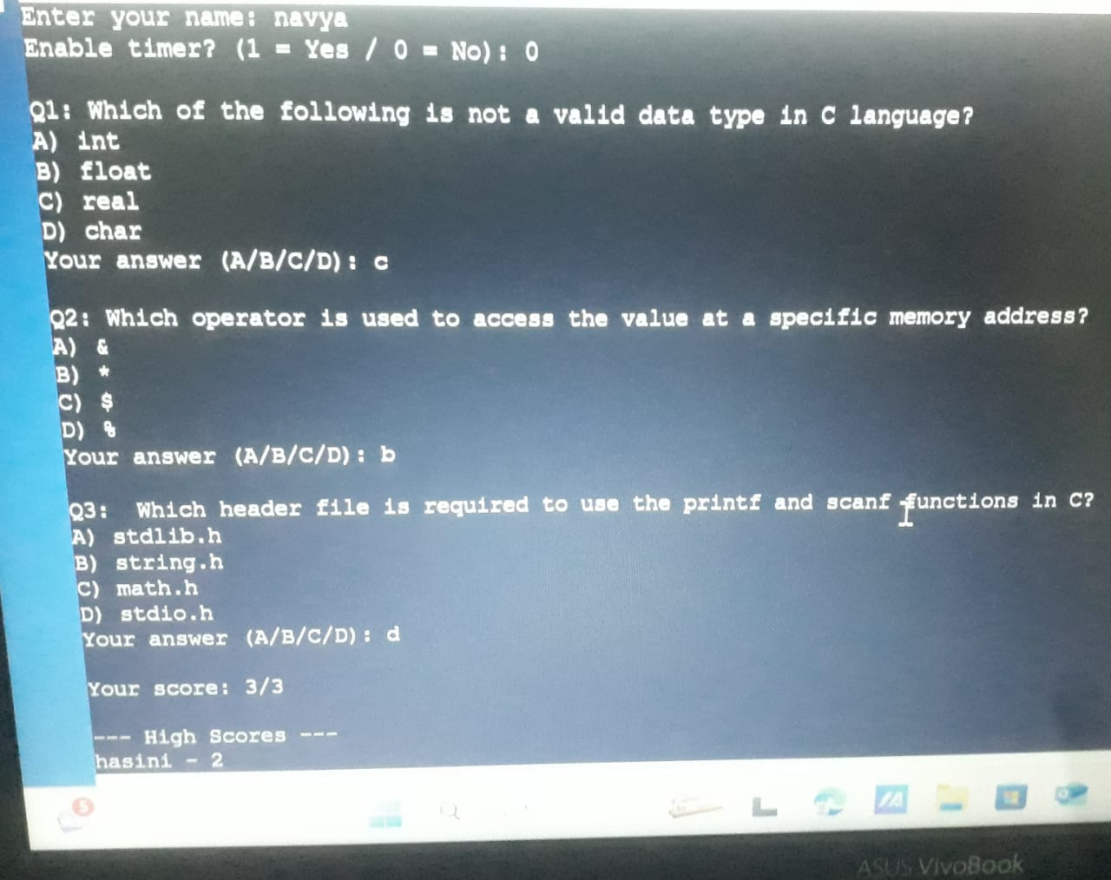
output sample

Slide 9
thank you

